Slide 1
ISIC 2024 - Skin Cancer Detection
Solution of Team „42”

Slide 2
Objectives, motivation
Medical image processing is a rapidly developing field. A preventive inspection can save lives. Ethical question: Can a doctor be replaced by a more accurate model? A phone app using a smaller model can help a lot of people. Goal: to achieve "quite good" results with as small a model as possible.

Slide 3
Previous solutions
The top 3 solutions: LGBM, XGBoost, CatBoost for tabular data and large models for transfer learning
These are really advanced techniques mainly used in competitions
We did not use these
The current mobile apps seem to utilize traditional image processing and domain knowledge

Slide 4
System design 1
We used the following pipeline for loading the data:
Download and unzip image- and metadata from Kaggle
We split the ids from the metadata to different „datasets”
We used the ids in the „datasets” to index images in the .hdf5 file

Slide 5
System design 2
We used the following pipeline for training the final model:
Train a convolutional autoencoder on a buch of benign data
Cut off the decoder and keep the encoder part
Train the model on a balanced train- valid- and test dataset

Slide 6
Our iterations
Anomaly detection
The noise caused by the skin surface suppressed the leisure reconstruction error
Transfer learning
EfficientNet
Different class weights
Balanced dataset

Slide 7
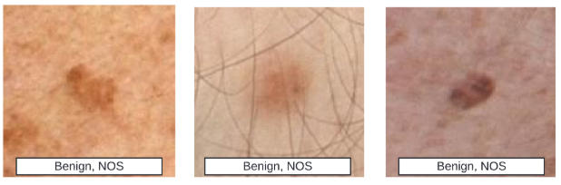
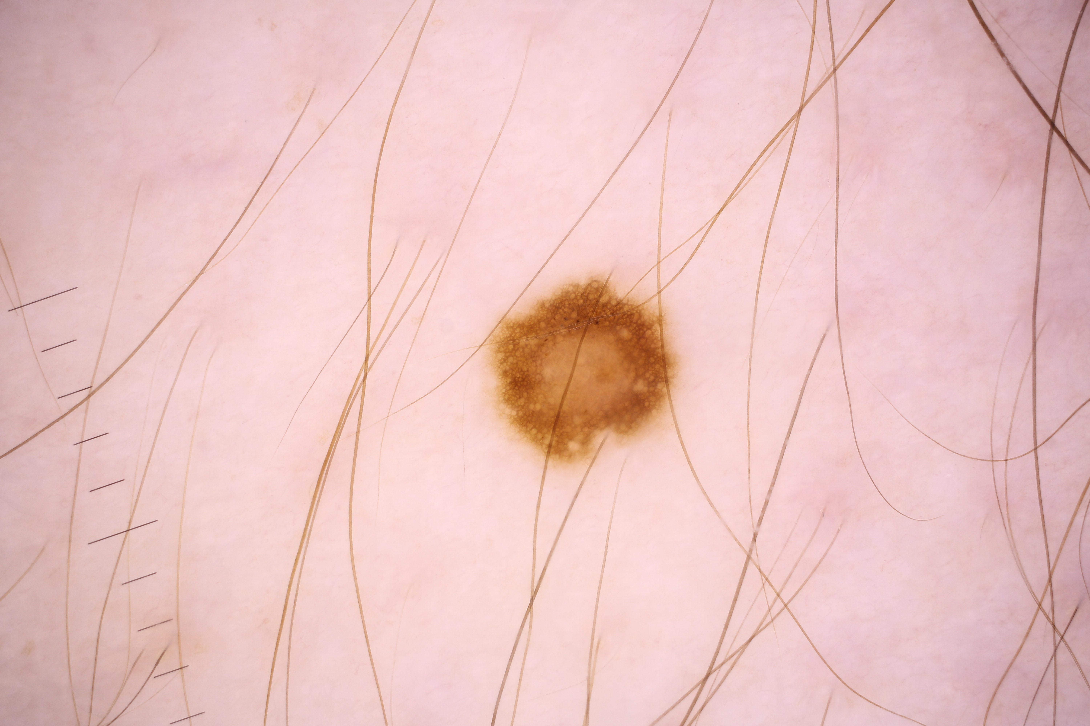
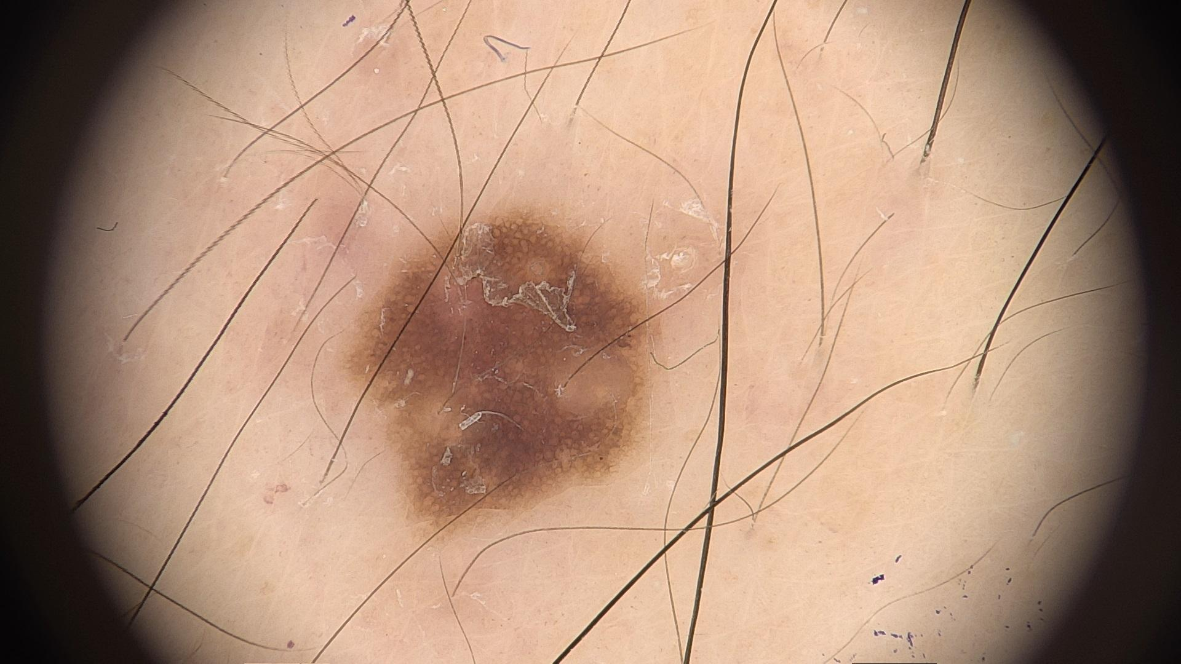
Database 1
We tried to use data from previous competitions
The result were terrible…
The model learned the databases instead of the features

Slide 8
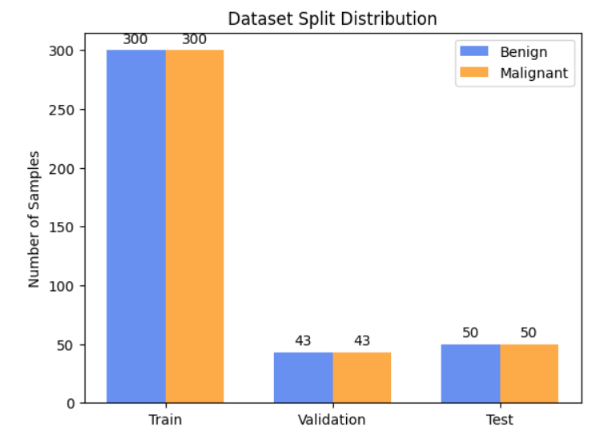
Database 2
In the end we used balanced datasets for training the classifier
We tried to use augmentation
The model learned the augmentation
We fixed the augmentation
The model overfitted to train
We gave up and use balanced datasets

Slide 9
A potential problem
!
Solution: better splitting of the train set
cluster 1
cluster 1
mal. 1
mal. 1
train
test
mal. 3
cluster 2
cluster 2
mal. 4
mal. 2

Slide 10
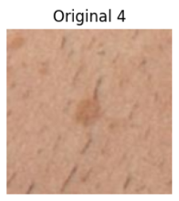
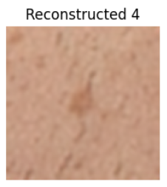
Architecture 1
First we train an autoencoder on a buch of benign data

Slide 11
Architecture 2
Then we cut the decoder and put a fully connected layer on top of the encoder
1
0
1
0
0
0
1
1
1

Slide 12

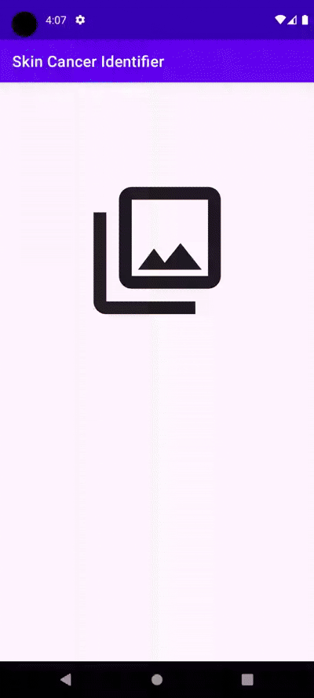
Demo
Android application to reach a wider audience
First we created a tflite model out of our trained model
Then generated metadata for the image classifier
Specified inputs and outputs for the application
Put the final tflite model into the Android application. Just select an image from your device and the model gives a prediction.

Slide 13
Summary 1
∑
Potential improvements:
More malignant data (hahaha)
Bigger autoencoder model
Basically more of everything…
Better train, valid and test splits might also help

Slide 14
Summary 2
∑
We tried and failed a lot
The results are far from great but at least we learned a lot
We belive that a smaller, domain specific convolutional model, utilizing autoencoder structure, trained from 0 is the way to go
Thanks for listening!

